Slide 1

The battle of neighborhoods
Office in Toronto

Slide 2
The battle of neighborhoods - office in Toronto
Both cities – New York and Toronto are quite large and have many common features.
are the biggest cities in their respective countries.
are the financial capitals in their respective countries.
are the most crowded cities in their respective countries.
According to ranking Best Places to Live in North America Toronto seems to be better place to live – ranked on the first place.
In the era of high mobility of employees, striving to improve the quality of life by employees, looking for work-life balance but also seeking lower costs of running a business, finding the answer on asked question can be interesting for a large group of entrepreneurs who want to move their headquarters to other countries:
Where would I recommend to open the new office taking into account similarity of the new and old location (venues availability)?

Slide 3
Data acquisition and cleaning
Toronto City data that contains Borough, Neighborhoods
Geographical Location data using Geocoder Package
New York data that contains Borough, Neighbourhoods, latitude and longitude
Venue Data using Foursquare API
In total 3717 rows and 7 features in the raw dataset.
All data has been cleaned.

Slide 4
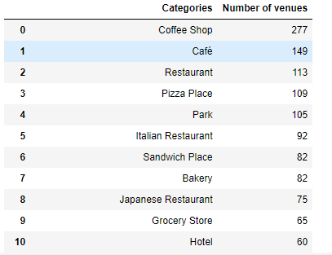
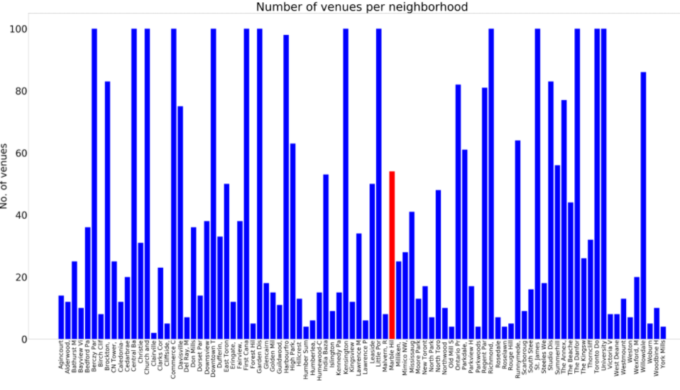
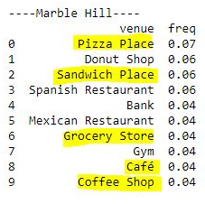
Analysis of neighborhoods

Slide 5
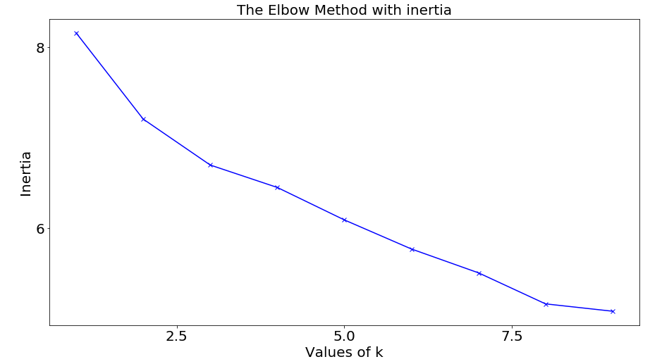
Cluster Neighborhoods
resulting of 8 clusters

Slide 6
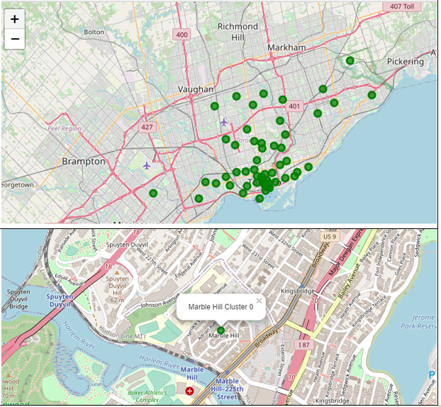
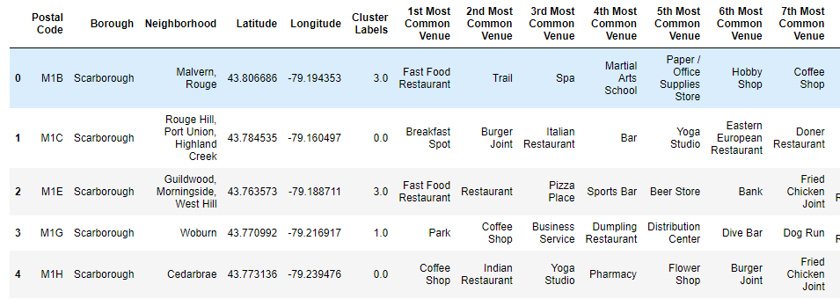
Cluster Neighborhoods - KMean

Slide 7
Conclusion and future directions
There is a great number of locations in Toronto which are similar to Marble Hill (56 places).
I would suggest to choose important venues for him or add other factors that would lead to a shortlist.
It would be useful to analyze the number of clusters once again with different method - The Elbow Method with inertia plot both k = 3 and k = 8 formed the elbow
The venue itself does not constitute an unequivocal decision as to whether a given venue is similar to the current office location. I recommend to use additional factors in the next analysis like:
attractiveness of each location,
traffic,
public transport,
cost of the rented space,
space availability,
social and economic dynamics of every neighborhood,
neighborhood safety etc.
Usually, in the vicinity of offices, there are the same attractions.
Final decision on optimal office location will be made by stakeholders based on specific characteristics of neighborhoods and locations in every recommended zone, taking into consideration The analysis performed may be the first step in the further search for the best place, depending on stakeholders decision.

